Slide 1
CSA1704 Artificial Intelligence
AI Multi-Modal Logistics OptimizatioPlatform
Presented By
Darwin Jacob N (192511457)
Teeka Raman S (192511131)
Sheik Mohamed M(192511145)
Guided By
Dr M Anoop

Slide 2







Introduction
Logistics moves goods between suppliers, warehouses, distribution centers, and customers.
Modern supply chains depend on multiple transport modes — Road, Rail, Air, and Sea.
Coordinating these modes needs intelligent planning and timely decisions.
Our platform applies AI and optimization to make logistics data-driven.
Supplier
↓
Warehouse
↓
Road / Rail / Air / Sea
↓
Distribution Center
Multi-modal transportation
Intelligent route planning
Resource optimization
↓
Customer
AI-based decision support
Sustainable logistics
02

Slide 3



Abstract
An intelligent web-based system to improve transportation and supply chain operations.
Integrates multiple transport modes with AI-based optimization for route planning, vehicle recommendation, warehouse allocation, and decision-making.
Reduces operational costs and delivery delays while improving resource utilization and sustainability.
MODULE 1
Intelligent Logistics Planning & Optimization
MODULE 2
Smart Resource & Warehouse Management
MODULE 3
AI Analytics & Decision Intelligence
PLATFORM FLOW
1
2
3
4
5
→
→
→
→
Logistics Data
AI Processing
Optimization
Intelligent Decision
Logistics Performance
03

Slide 4

Existing System
Manual planning
Static transportation schedules
Spreadsheet-based records
Predefined routes
Separate warehouse systems
Rule-based vehicle selection
Basic reporting
Manual Planning
Warehouse System
Spreadsheets
Transport System
Reporting
Fragmented Data → Limited Intelligence → Delayed Decisions
06

Slide 5



Limitations of Existing System
High Cost
Limited Prediction
Inefficient planning increases transportation expenses.
Traditional systems offer limited forecasting.
Route Inefficiency
Poor Integration
Static planning cannot adapt to changing conditions.
Transportation and warehouse operations stay disconnected.
Resource Waste
Environmental Impact
Vehicles and warehouse capacity are underutilized.
Inefficient routes raise fuel use and emissions.
Need for an Integrated AI-Powered Logistics Intelligence Platform
07

Slide 6

Proposed System
The proposed platform integrates transportation, warehouse, vehicle, and operational data into a centralized AI-driven environment.
DATA INPUT
↓
AI INTELLIGENCE ENGINE
Multi-modal route optimization
Shipment planning
Vehicle recommendation
Warehouse allocation
Resource & cost analytics
Carbon analytics
Predictive intelligence
AI logistics assistant
↓
ROUTE AI
RESOURCE AI
ANALYTICS AI
↓
INTELLIGENT DECISION
↓
LOGISTICS OPERATIONS
↓
PERFORMANCE FEEDBACK
08

Slide 7
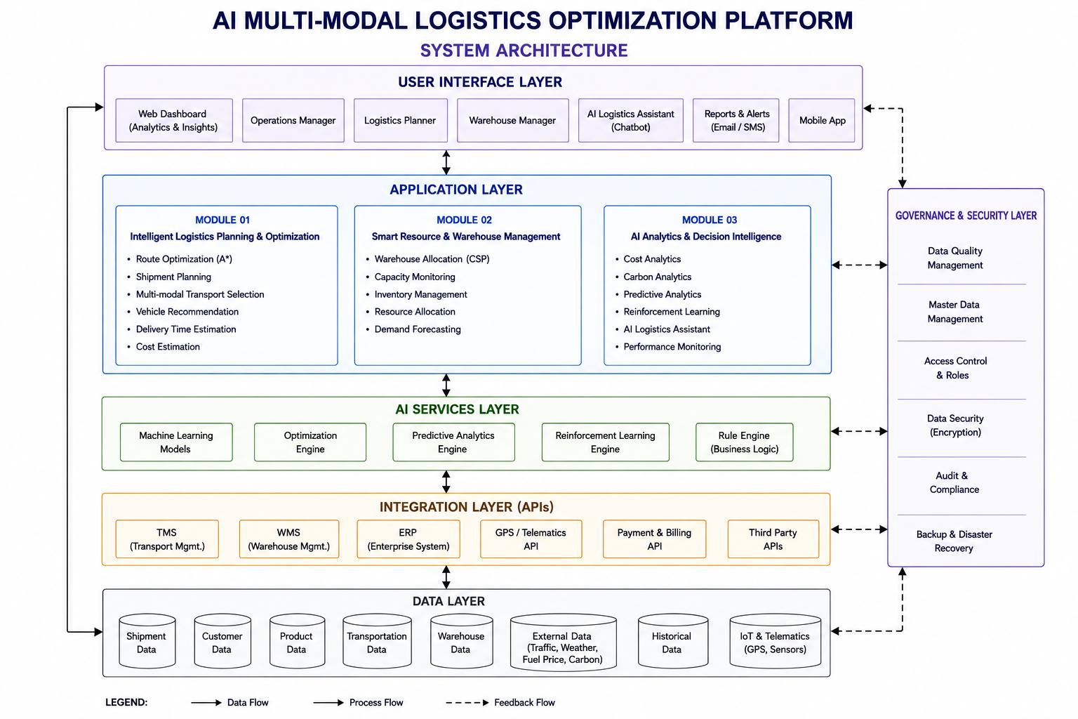

Slide 8
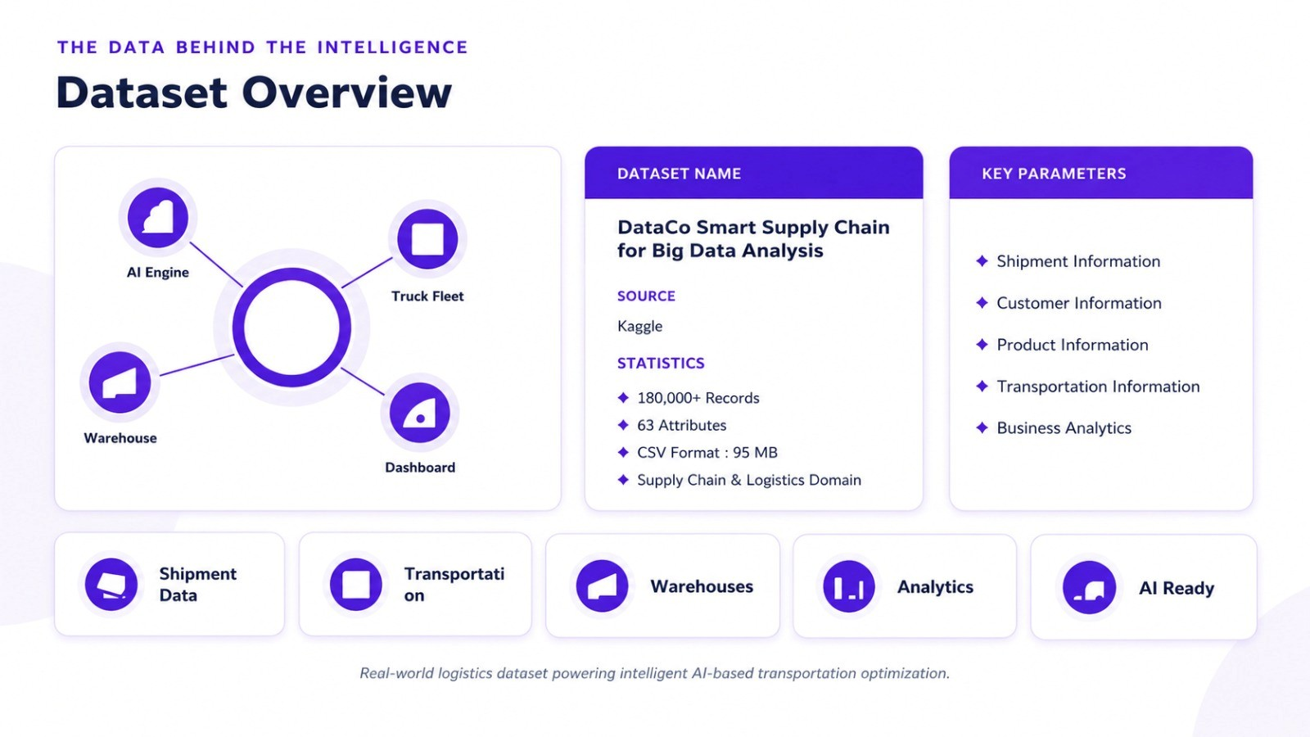

Slide 9




System Modules
MODULE 01
MODULE 02
MODULE 03
Intelligent Logistics
Planning & Optimization
Smart Resource &
Warehouse Management
AI Analytics &
Decision Intelligence
FOCUS
FOCUS
FOCUS
Transportation
Resources
Intelligence
FUNCTIONS
FUNCTIONS
FUNCTIONS
Route Optimization
Shipment Planning
Vehicle Recommendation
Transport Mode Selection
Warehouse Allocation
Capacity Monitoring
Inventory Management
Resource Allocation
Cost Analytics
Carbon Analytics
Predictive Analytics
AI Assistant
09

Slide 10




MODULE 01
Intelligent Logistics Planning & Optimization
OBJECTIVE
Identify efficient transportation routes and recommend suitable transportation resources according to shipment requirements.
AI ROUTE MAP · CHENNAI → MUMBAI
CHENNAI
FUNCTIONS
Shipment planning
Route optimization
Multi-modal transport selection
Vehicle recommendation
Delivery time estimation
Cost estimation
BENGALURU
MUMBAI
TRANSPORT MODES
AI-Selected Optimal Route (Rail + Road)
Alternative Routes Considered
Road
Rail
Air
Sea
10

Slide 11
MODULE 01
How Module 01 Works
1
2
3
4
→
→
→
Source & Destination
Shipment Details
Available Transport Modes
Route Generation
↓
5
6
7
8
→
→
→
Cost & Distance Analysis
AI Optimization
Best Route
Vehicle Recommendation
INPUT
OUTPUT
Source · Destination · Cargo Type · Cargo Weight · Delivery Requirement
Optimal Route · Estimated Cost · Delivery Time · Recommended Vehicle
11

Slide 12

MODULE 01
Algorithms Used in Module 01
ALGORITHM 01
ALGORITHM 02
A* Search
Decision Tree
PURPOSE
PURPOSE
Optimal route selection across the transport network.
Vehicle recommendation based on shipment attributes.
f(n) = g(n) + h(n)
DECISION FACTORS
1
Cargo weight
WHERE
2
Cargo type
g(n) = Cost from start to node n
h(n) = Estimated cost to destination
f(n) = Total estimated path cost
3
Distance
4
Delivery requirement
12

Slide 13
MODULE 01
Module 01 — Algorithm Working
A* SEARCH — NODE EXPANSION
DECISION TREE — VEHICLE SELECTION
B
5
D
Cargo Weight
START
A
4
4
GOAL
2
↓
3
2
Distance
C
2
E
↓
Cargo Type
↓
f(n) = g(n) + h(n)
Vehicle Recommendation
Selected Path: START → A → C → E → GOAL
Total Path Cost = 2 + 3 + 2 + 2 = 9
RECOMMENDED OUTPUT
Transport: Rail + Road
Vehicle: Based on cargo & distance conditions
13

Slide 14
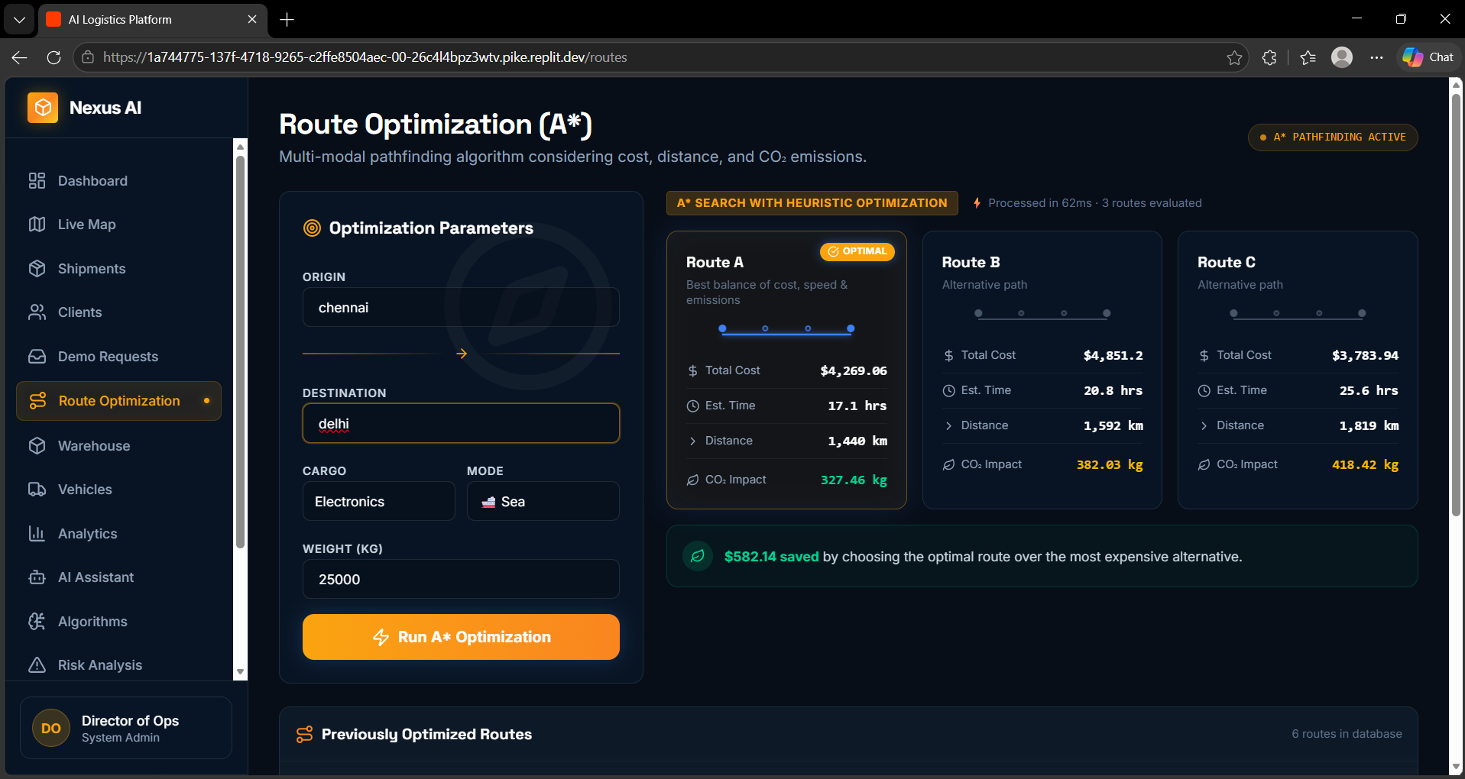
OUTPUT WINDOW

Slide 15

MODULE 02
Smart Resource & Warehouse Management
OBJECTIVE
Warehouse A
95%
Optimize warehouse capacity and allocate resources according to storage requirements and operational constraints.
95% UTILIZED
FUNCTIONS
Warehouse B
60%
Warehouse allocation
Capacity monitoring
Inventory management
Storage optimization
Resource allocation
Constraint monitoring
60% UTILIZED
Warehouse C
80%
80% UTILIZED
New Shipment Incoming
AI evaluates capacity, compatibility & priority → selects Warehouse B
14

Slide 16
MODULE 02
How Module 02 Works
Warehouse Data
CSP Processing
1
5
INPUT
Warehouse capacity
Inventory requirement
Storage type
Priority
Resource availability
↓
↓
Available Capacity
Validation
2
6
↓
↓
Inventory Requirements
Optimal Allocation
3
7
↓
↓
OUTPUT
Define Constraints
Warehouse Dashboard
4
→
8
Assigned warehouse
Available capacity
Allocation status
Utilization percentage
15

Slide 17


MODULE 02
Algorithms Used in Module 02
ALGORITHM 01
ALGORITHM 02
Constraint Satisfaction
First Order Logic
PURPOSE
PURPOSE
Find feasible warehouse allocations while satisfying multiple constraints.
Validate logistics business rules before finalizing allocation.
CORE COMPONENTS
EXAMPLE RULE
Variables
Domains
IF Vehicle Capacity ≥ Cargo Weight
Constraints
Solutions
↓
THEN Vehicle is Eligible
16

Slide 18
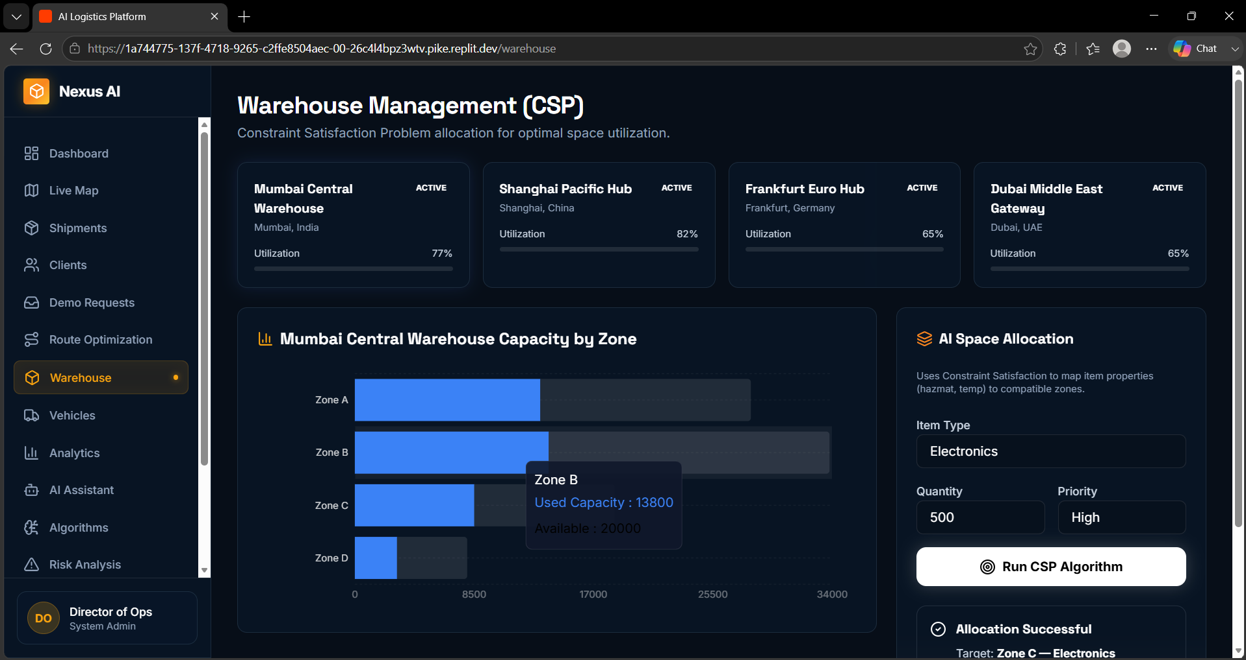
OUTPUT WINDOW
OUTPUT WINDOW

Slide 19
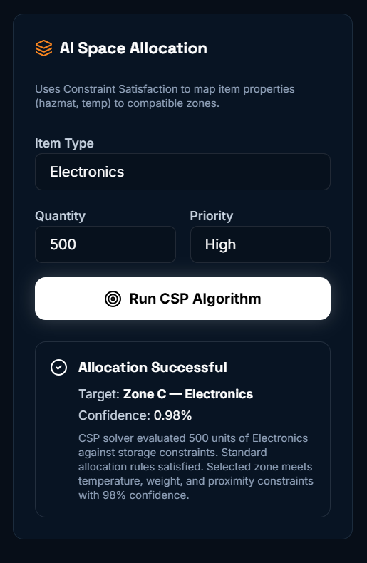

Slide 20
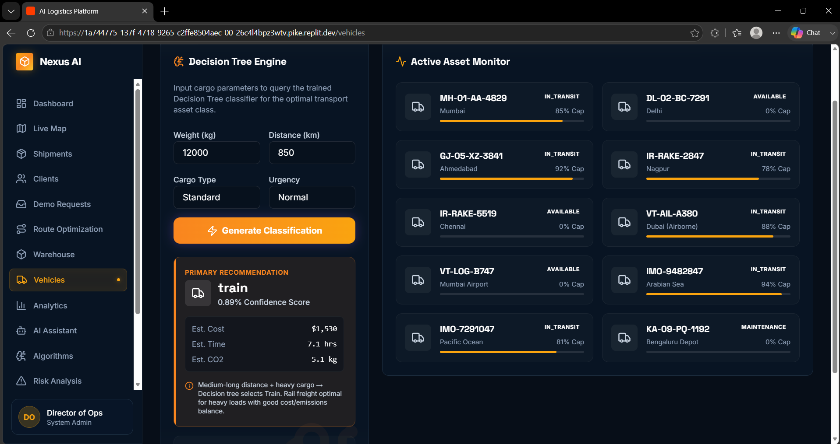
OUTPUT WINDOW

Slide 21
MODULE 03
AI Analytics & Decision Intelligence
OBJECTIVE
Transform logistics data into actionable insights, predictions, and intelligent recommendations.
LOGISTICS ANALYTICS DASHBOARD
FUNCTIONS
18%
96%
87%
22%
Cost analytics
Carbon analytics
Route performance
Shipment analytics
Predictive analytics
AI assistant
Performance monitoring
Cost Reduction
Route Success
Vehicle Utilization
Carbon Reduction
COST TREND
CARBON EMISSIONS
AI INSIGHT
Rail + Road combination reduces cost by 18% on the Chennai–Mumbai corridor.
18

Slide 22
MODULE 03
How Module 03 Works
Logistics Data
Prediction
1
6
DATA SOURCES
Shipment History
Route Data
Cost Data
Delivery Time
Vehicle Utilization
Carbon Data
↓
↓
Data Collection
Recommendation
2
7
↓
↓
Data Processing
Decision
3
8
↓
↓
Pattern Analysis
Performance Feedback
4
9
TRANSFORMS INTO
Charts & Dashboards
Predictions
Recommendations
Decisions
↓
↓
AI Model
5
→
19

Slide 23

MODULE 03
Algorithms & AI Techniques in Module 03
ALGORITHM 01
ALGORITHM 02
Reinforcement Learning
Predictive Analytics
PURPOSE
PURPOSE
Continuously improve logistics decisions using feedback.
Identify patterns and forecast future logistics requirements.
FLOW
FLOW
Agent
Historical Data
Action
Pattern Detection
Environment
Trend Analysis
Reward / Penalty
Prediction
Learning
Recommendation
Improved Action
20

Slide 24

MODULE 03
Module 03 — AI Decision Intelligence
REINFORCEMENT LEARNING LOOP
PREDICTIVE ANALYTICS
State
Update
Action
Historical
Data
Pattern
Analysis
Forecast
AI
Recommendation
Reward
Environment
→
→
→
Result
AI LOGISTICS ASSISTANT
Rail + Road
22%
16 Hours
96%
USER: Find the best route from Chennai to Mumbai.
Recommended Route
Est. Cost Saving
Est. ETA
Confidence
Demonstration example — illustrative figures, not experimentally validated results.
21

Slide 25
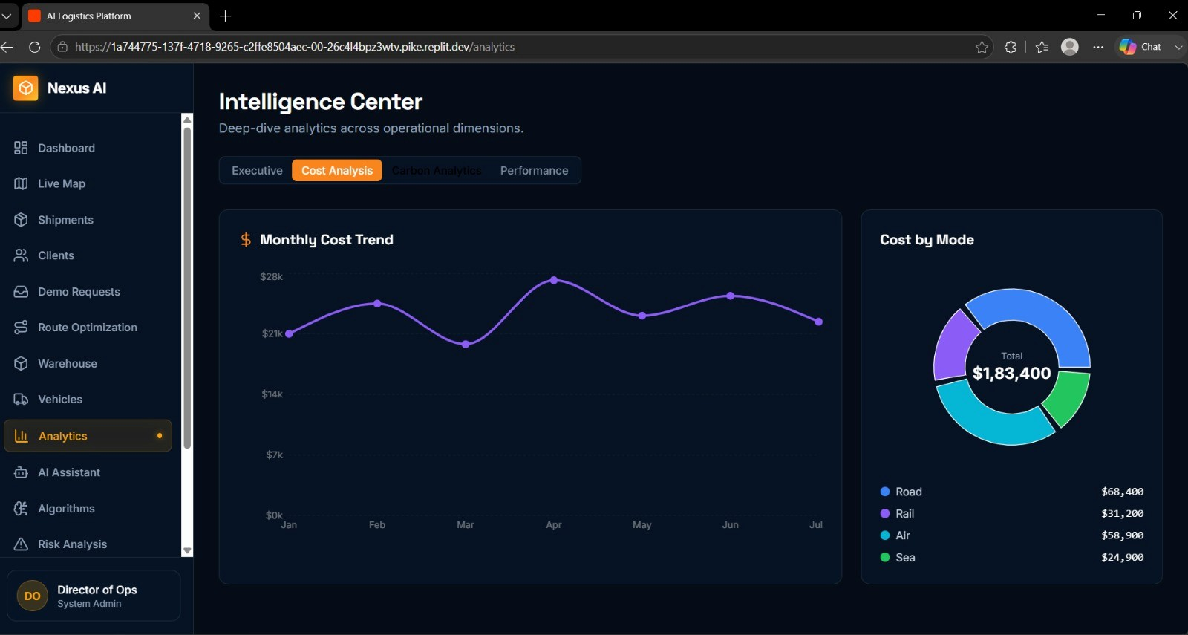
OUTPUT WINDOW

Slide 26
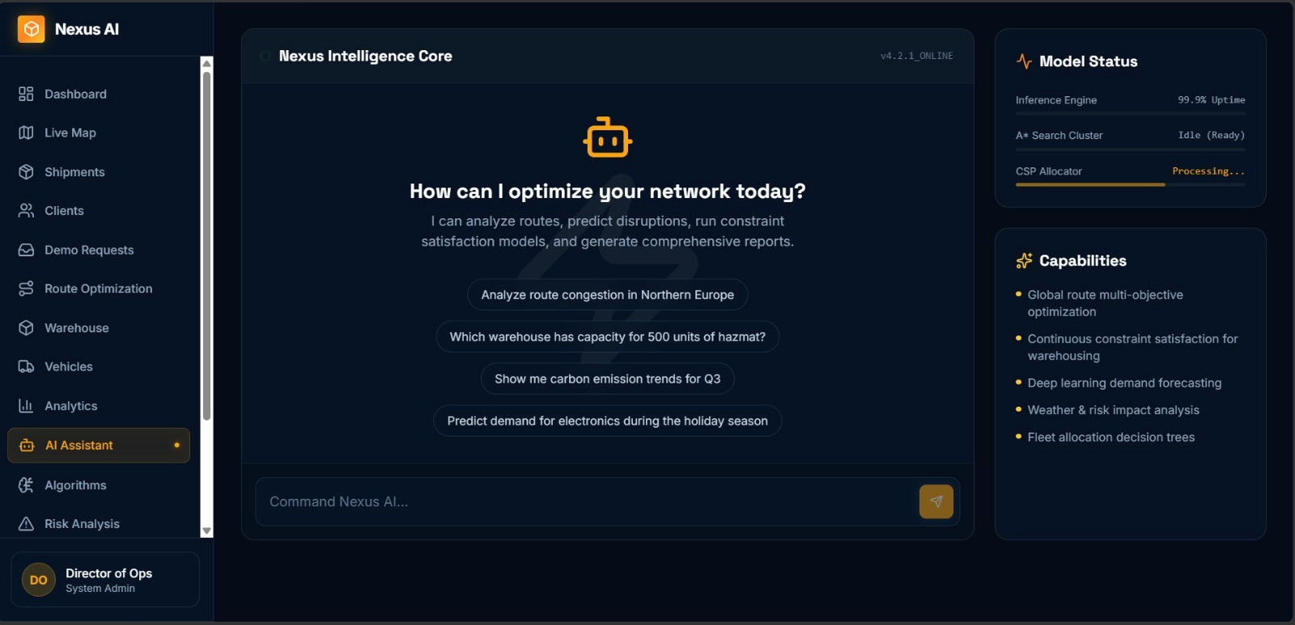
OUTPUT WINDOW

Slide 28
Reference
[1] P. E. Hart, N. J. Nilsson, and B. Raphael, “A formal basis for the heuristic determination of minimum cost paths,” IEEE Transactions on Systems Science and Cybernetics, vol. 4, no. 2, pp. 100–107, 1968.
[2] J. R. Quinlan, “Induction of decision trees,” Machine Learning, vol. 1, pp. 81–106, 1986.
[3] A. K. Mackworth, “Consistency in networks of relations,” Artificial Intelligence, vol. 8, no. 1, pp. 99–118, 1977.
[4] R. S. Sutton and A. G. Barto, Reinforcement Learning: An Introduction, 2nd ed., MIT Press, 2018.
[5] M. Christopher, Logistics & Supply Chain Management, 5th ed., Pearson, 2016.

Slide 29






THANK YOU
AI Multi-Modal Logistics Optimization Platform
26

